Slide 1
CSI2005 Principles of Compiler Design
MODULE – 1
Dr. WI. Sureshkumar
Associate Professor
School of Computer Science and Engineering (SCOPE)
VIT Vellore
wi.sureshkumar@vit.ac.in
SJT413A34

Slide 2
Objective
To provide required theoretical foundation for a computational model and compiler design
To focus the compiler algorithms more on low level system aspects
To use tools such as Lex, YACC to automate parts of implementation process
To understand the principles of code optimization techniques.

Slide 3
Text books
Principles of Compiler Design, Alferd V. Aho and Jeffery D. Ullman, Addison Wesley, 2006
Engineering a compiler, K. D. Cooper and L. Torczon, Morgan Kaufmann, 2nd edition, 2011.
Advanced Compiler design implementation, Steven S.Muchnick, Elsevier Science India, 2003.
Modern Compiler Implementation in Java, Andrew A.Appel, Cambridge University Press, 2nd edition, 2002.
Compiler Design in C, Allen Holub, Prentice Hall, 1990.
Basics of Compiler Design, Torbengidius Mogensen, Springer, 2011.

Slide 4
Mode of Evaluation
DA 10 Marks
QUIZ-1 10 Marks (Moddle)
QUIZ-2 10 Marks (Moddle)
CAT - 1 15 Marks (Closed Book)
CAT - 2 15 Marks (Open Book)
FAT 40 Marks
Total 100 Marks

Slide 5
Module -1
Introduction to Compilation and Lexical Analysis
Introduction to programming language translators
Structure and phases of a compiler
Design issues, Patterns, lexemes, Tokens, Attributes
Specification of Tokens
Extended Regular expression
Regular expression to Deterministic Finite Automata (Direct method).

Slide 6
A program that reads a program written in one language (source language) and
translates it into an equivalent program in another language (target language).
INTERPRETER (BASIC , SNOBOL)
COMPILER ( Pascal, C, FORTRAN)
HLL
Source Program
LLL
Target Program
Compiler
Error messages

Slide 7
Compiler:
a program that translates an executable program in one language into an executable program in another language
we expect the program produced by the compiler to be better, in some way, than the original
Interpreter:
a program that reads an executable program and produces the results of running that program
usually, this involves executing the source program in some fashion
Our course is mainly about compilers but many of the same issues arise in interpreters

Slide 8
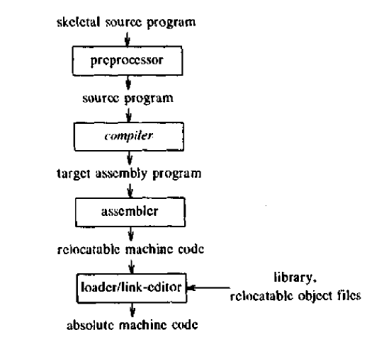

Slide 9
Phases of Compiler
Lexical analyzer
Syntax analyzer
Semantic analyzer
Intermediate code generator
Code optimizer
Code generator
Symbol table
Error handler

Slide 10
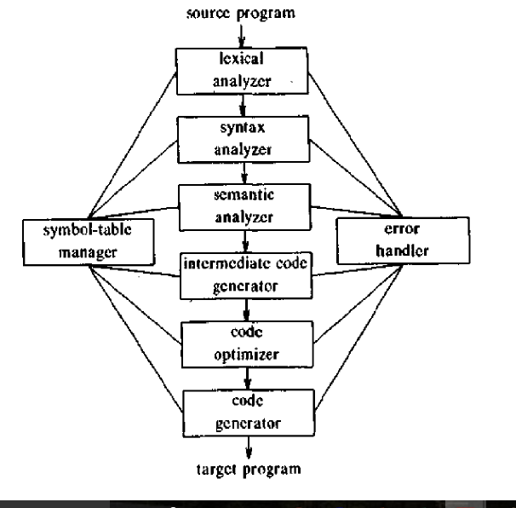
Phases of Compiler

Slide 11
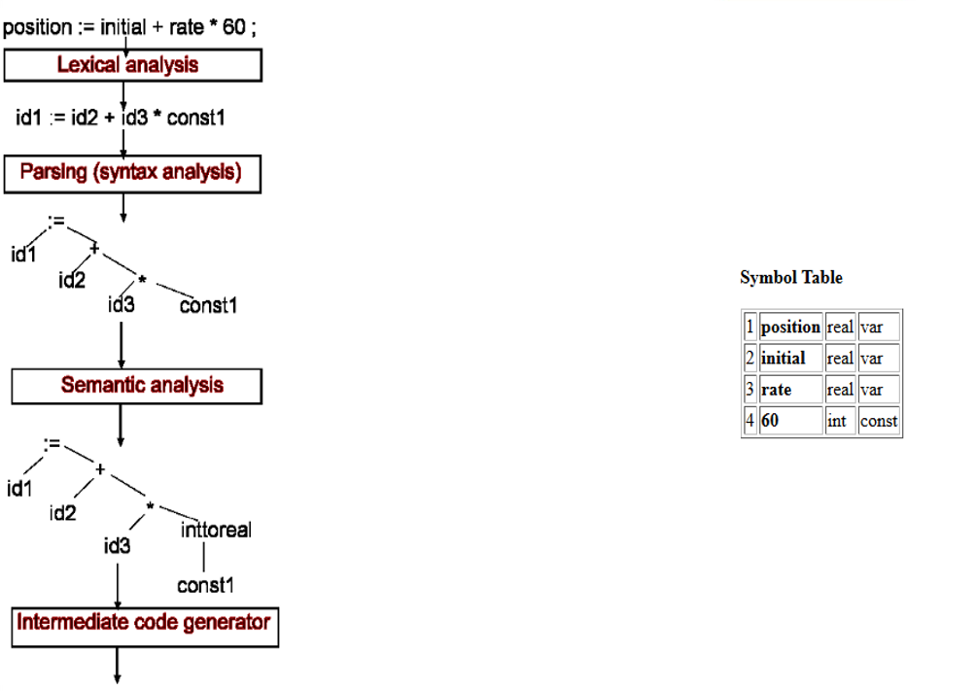

Slide 12
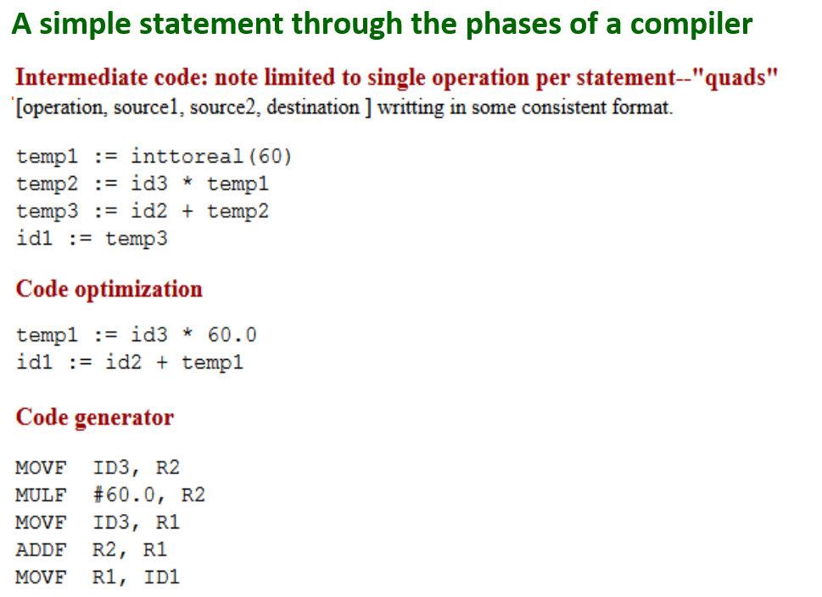

Slide 13
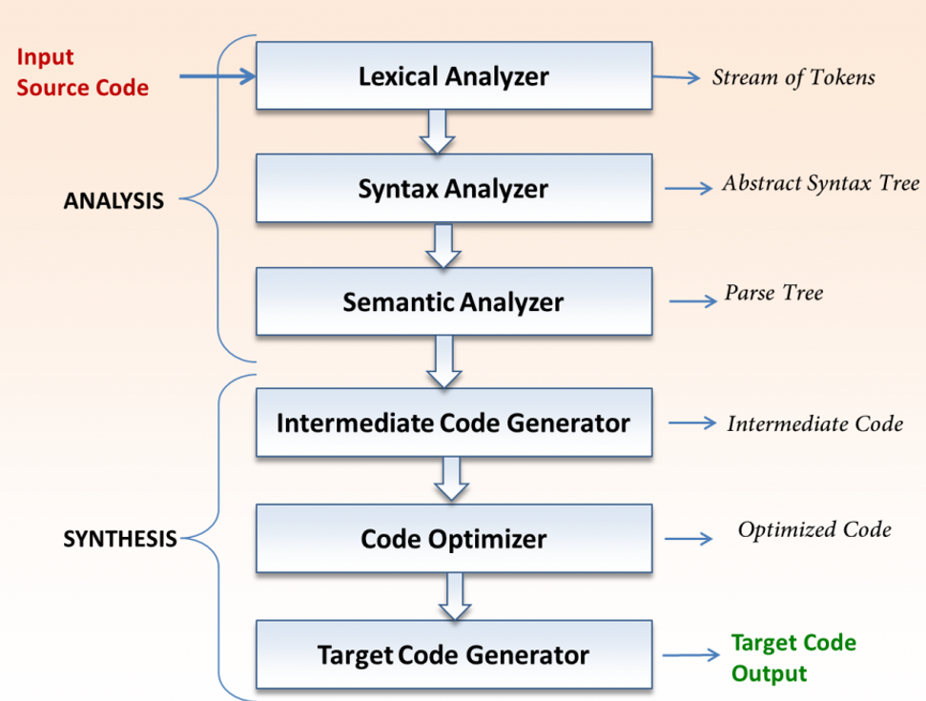

Slide 14
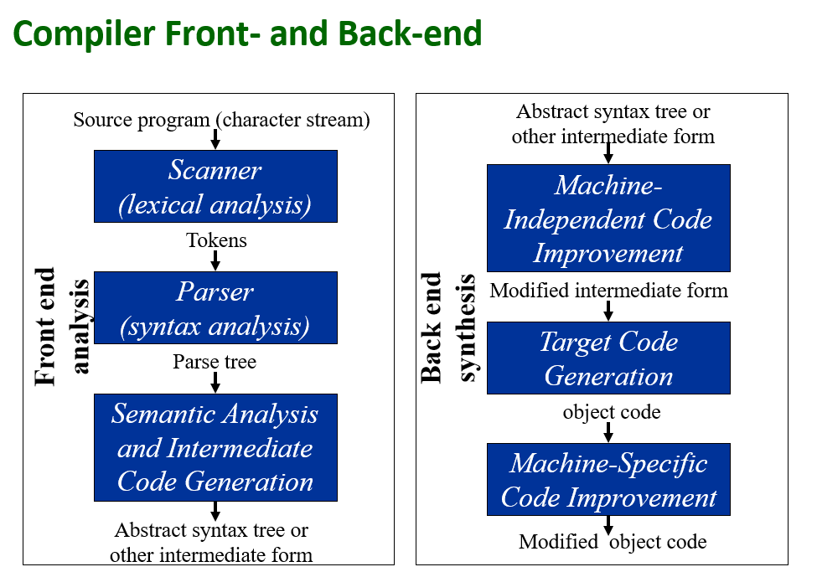

Slide 15
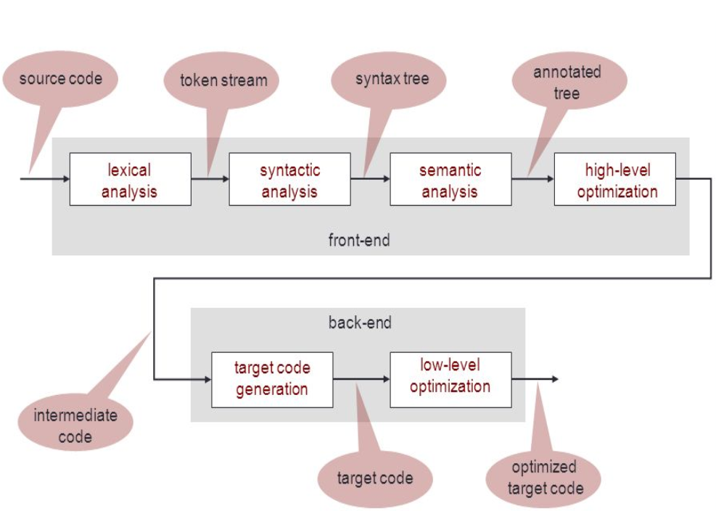

Slide 16
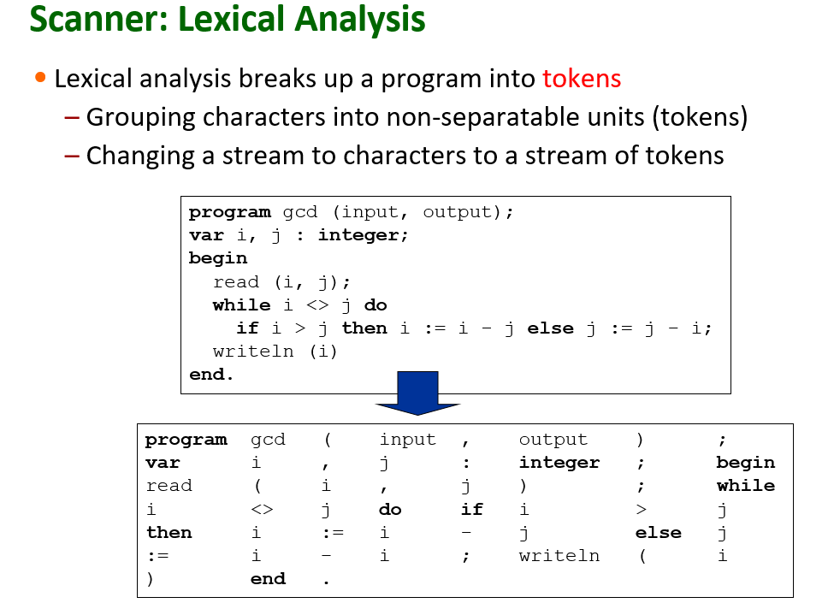

Slide 17
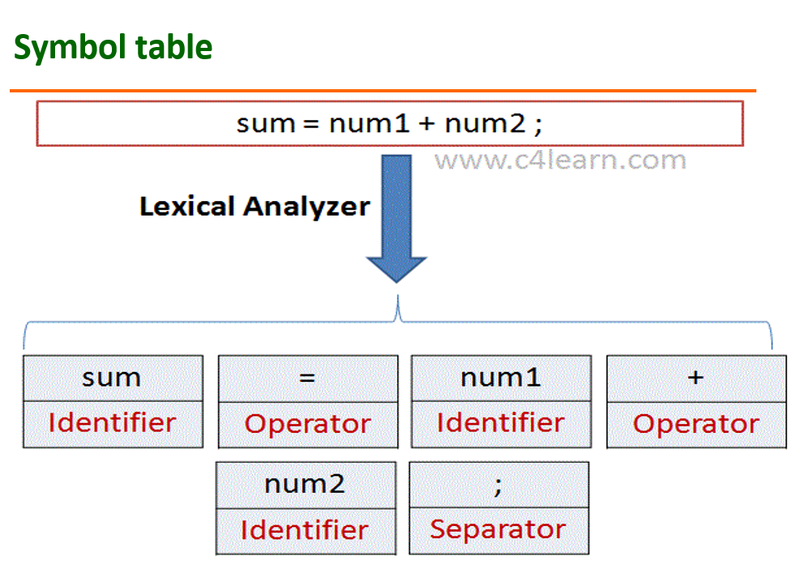

Slide 18
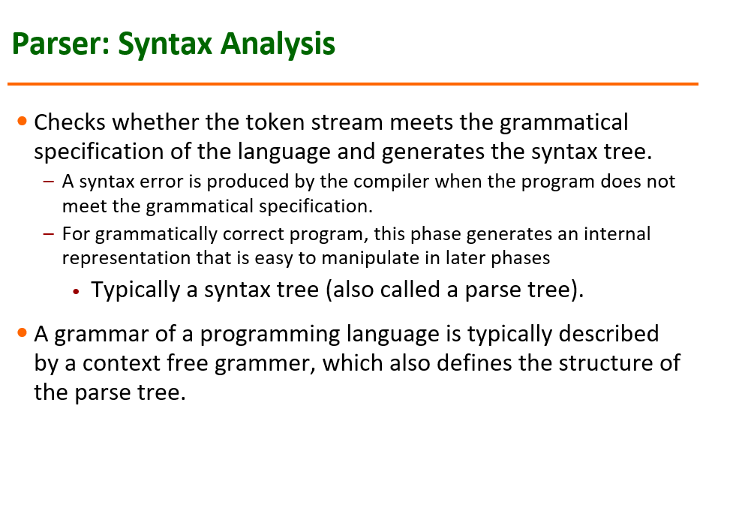

Slide 19
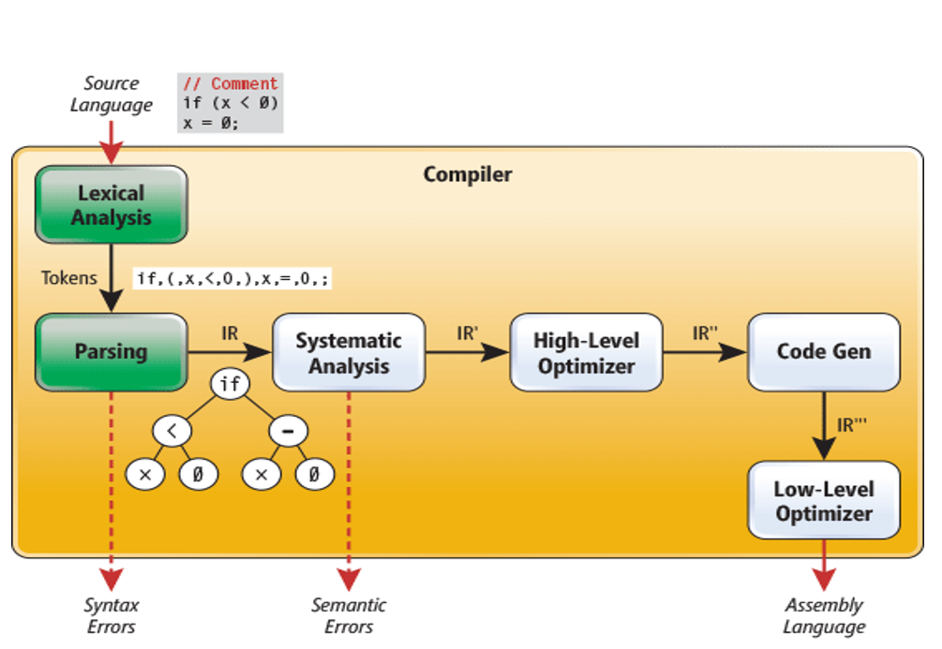

Slide 20
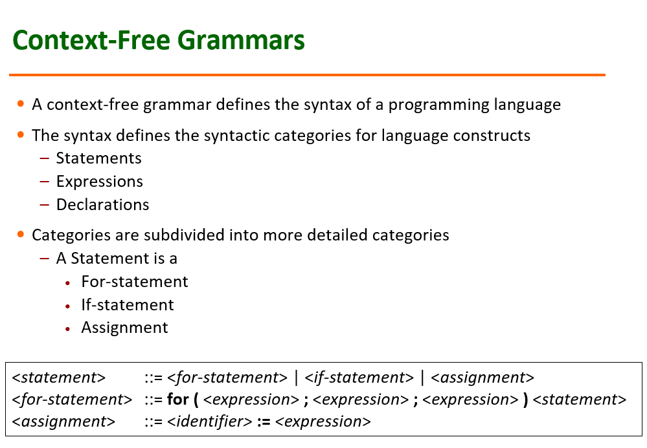

Slide 21
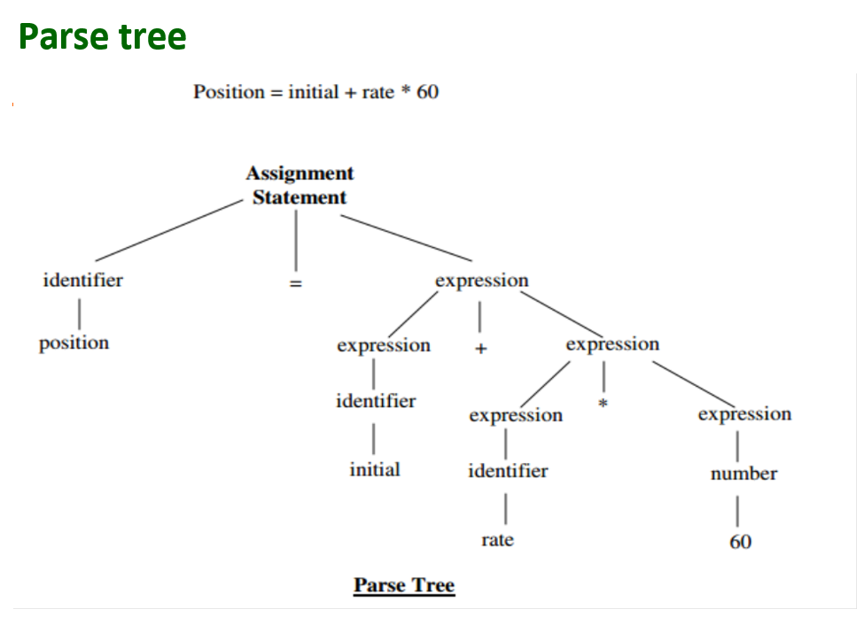

Slide 22
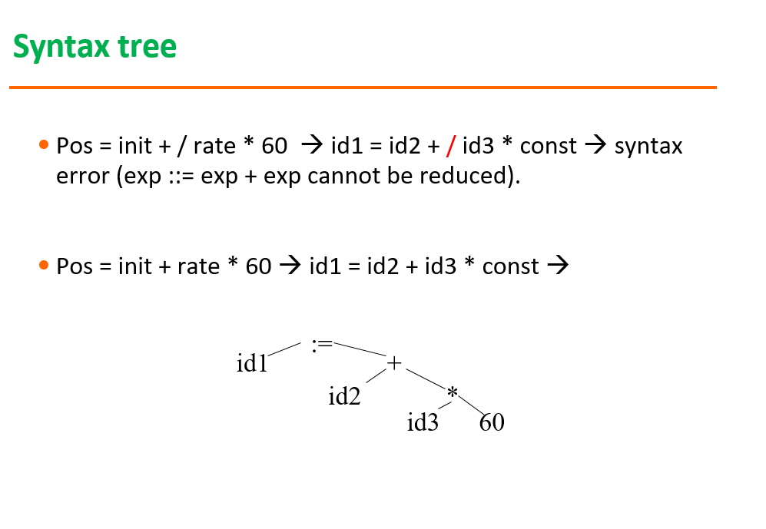

Slide 23
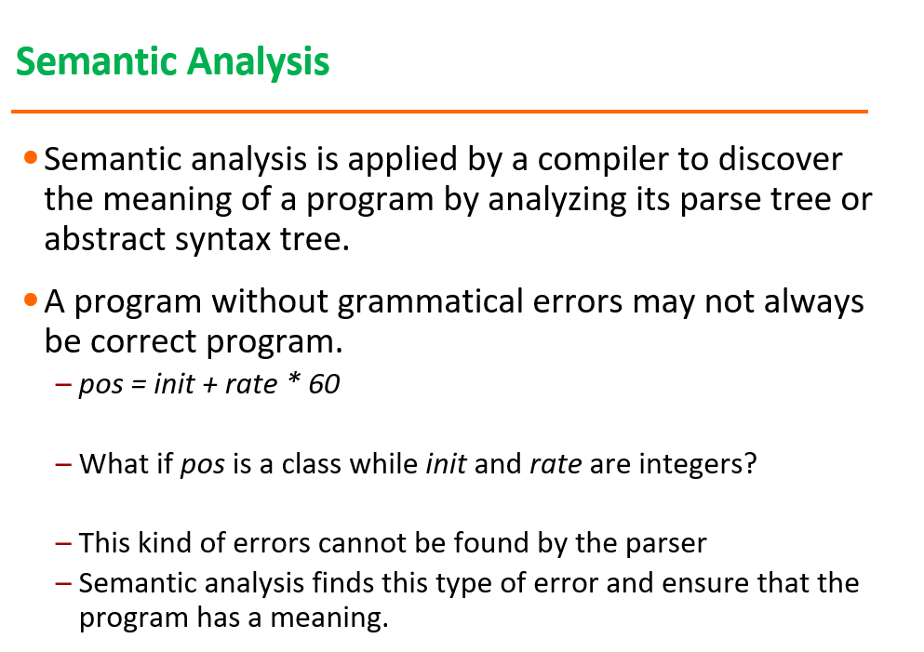

Slide 24
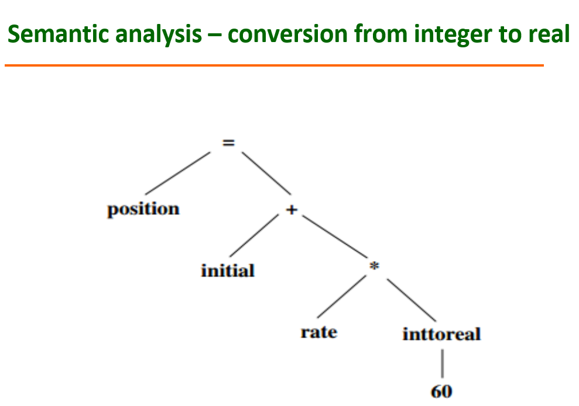

Slide 25
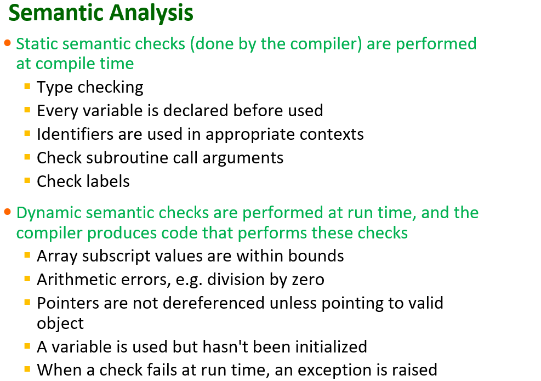

Slide 26
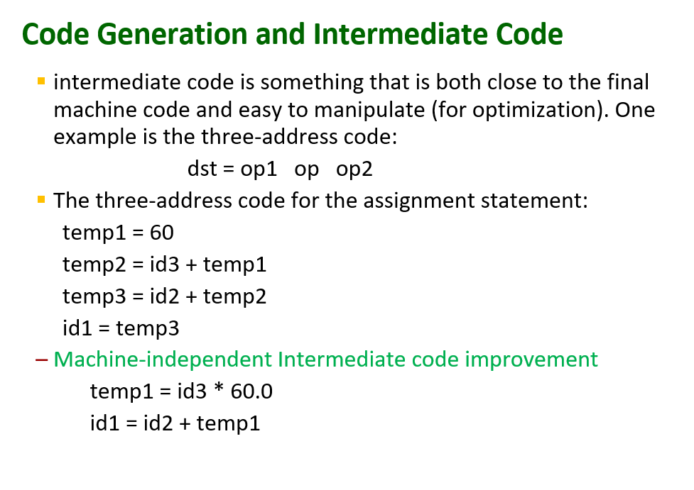

Slide 27
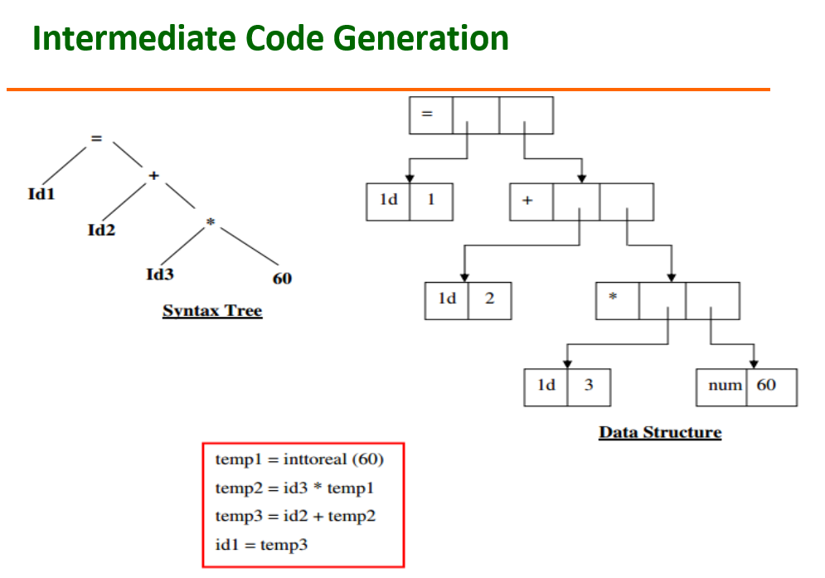

Slide 28
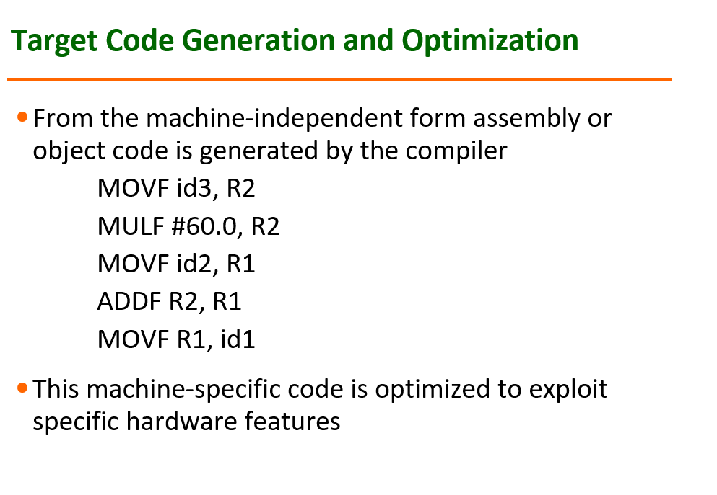

Slide 29
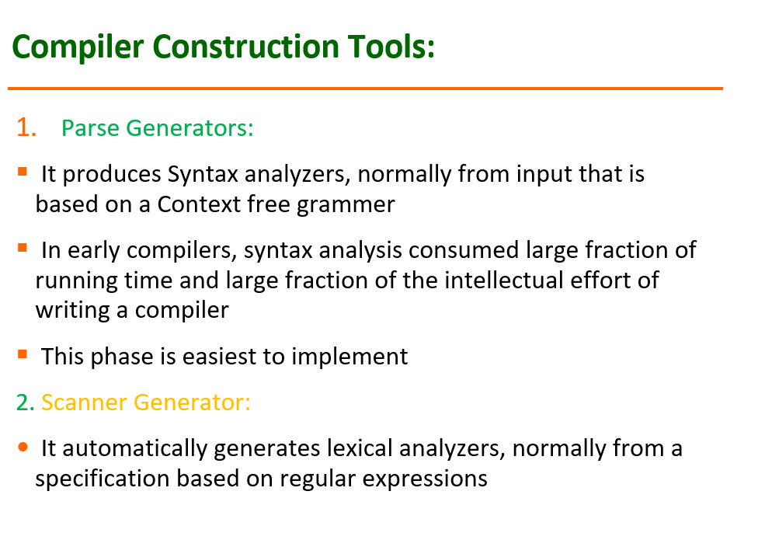

Slide 30
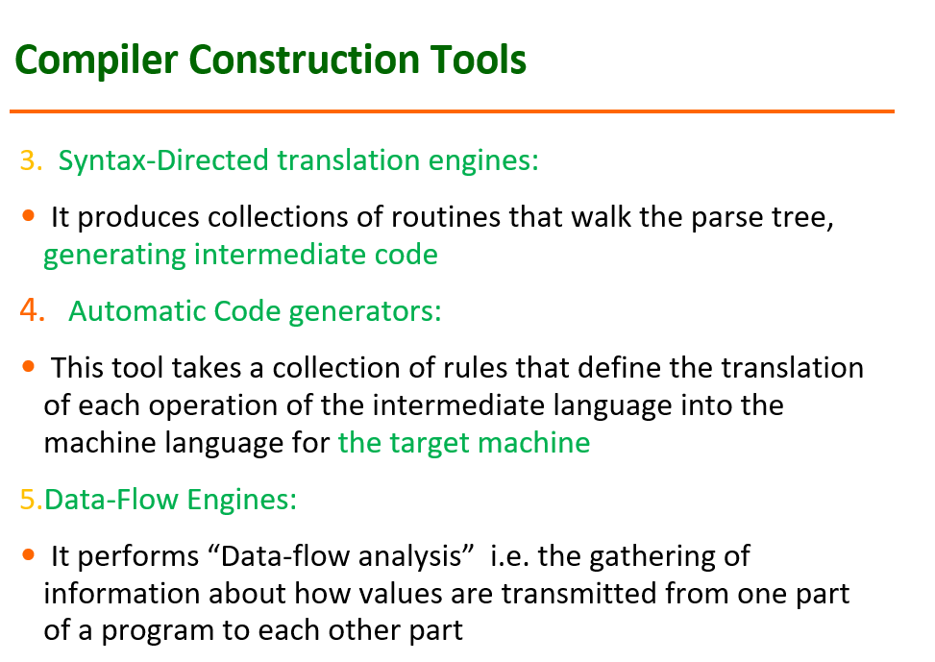

Slide 31
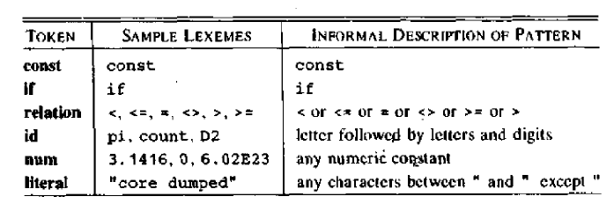

Slide 32
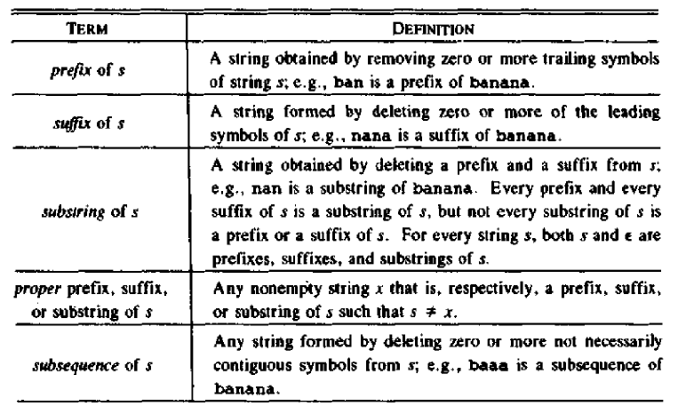

Slide 33
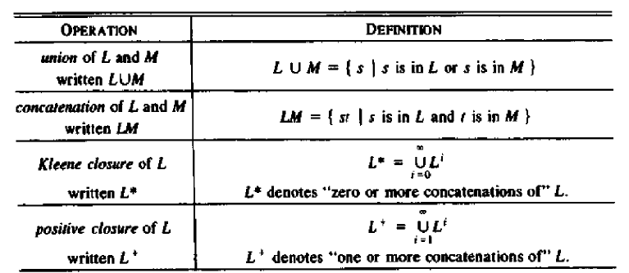

Slide 34
